Slide 1

FIFA MONEY BALL 2023
Benfica Team

Slide 2
DEFINE THE
OUTCOME
Based on the Fifa Money Ball 2023 data set, predict the market value for the new players to come.
1
DATA
EXPLORATION
Understand the information given in the Fifa Money Ball 2023 data set & check if data cleaning is needed.
2
Benfica Team
3
DATA
PRÉPARATION
Several tests to determine which features will perform best for our target (“Market value”) and create the linear regression model.
3
CONCLUSION
4
Interpret the results obtained with our linear regression model.

Slide 3
DATA EXPLORATION
&
DEVELOPMENT SAMPLE PREPARATION

Slide 4
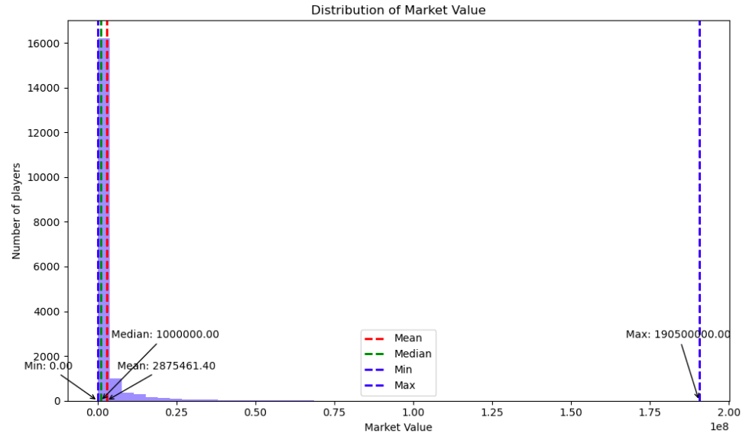
EXPLORATION STEP
Let’s take a look at the distribution of the Market value column. This is very skewed.

Slide 5
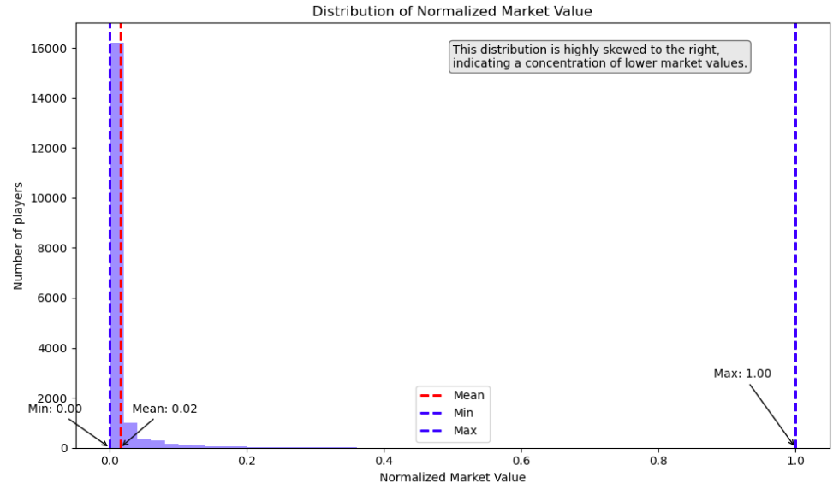
NORMALIZATION STEP
Let’s try to normalize the market value column using log transformation and see if we can reduce the skewness in the data distribution. This is still very skewed.

Slide 6
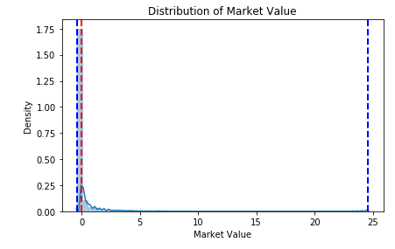
STANDARDIZATION STEP
Looking more at the data set, we actually some players with very high market value. We decided the remove the outliers of our data set. After several tests, we used the 90th percentile as a threshold to remove outliers and work with a reduced set of values. In other words, we considered 10% of players with the highest market values, were considered extreme values or outliers in this context.

Slide 7
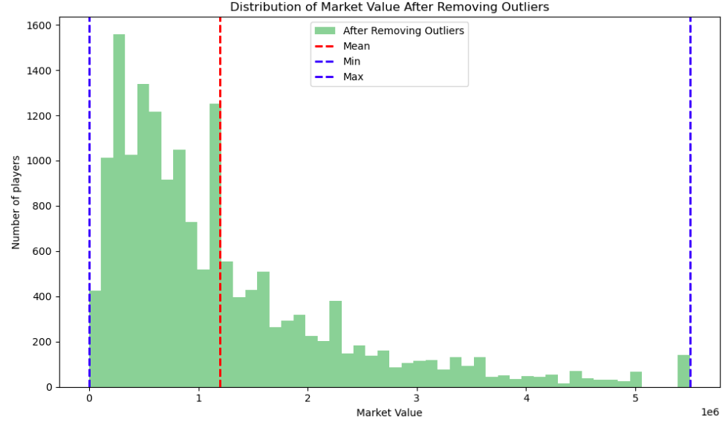
DATA WITHOUT OUTLIERS
It seems we have more readability when we let the outliers aside, as they extremely influence the market value distribution. Let’s keep working on a reduced data set without the outliers.

Slide 8
CORRELATION ANALYSIS
&
EXPERT CRITERIA

Slide 9
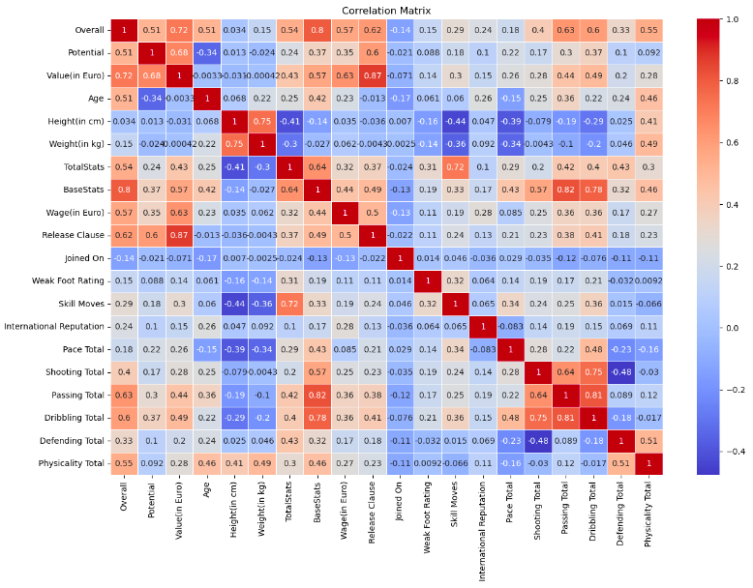
DATA PREPARATION
We found which features we would like to keep to create our linear regression and build our market value predictive model.
To determine them, we use a correlation heatmap for our NUMERICAL values to quickly identify and visualize relationships between variables in a dataset.

Slide 10
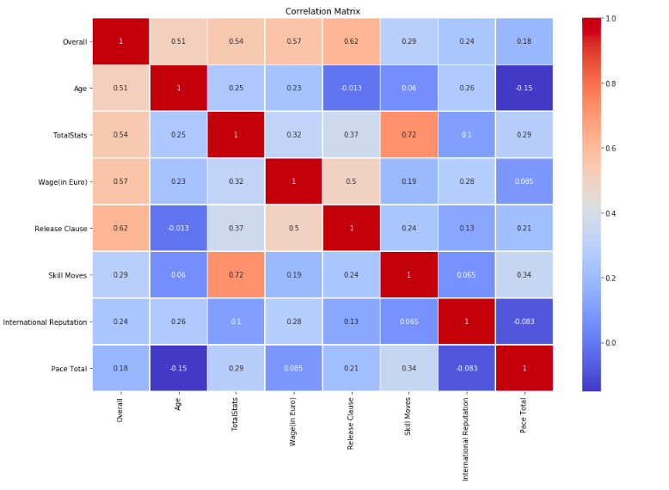
DATA PREPARATION
Let’s examine the high correlated columns and see if we can leave aside columns with repetitive information.
We fine-tuned the correlation matrix and drop more columns.

Slide 11
MODEL DEVELOPMENT PROCESS

Slide 12
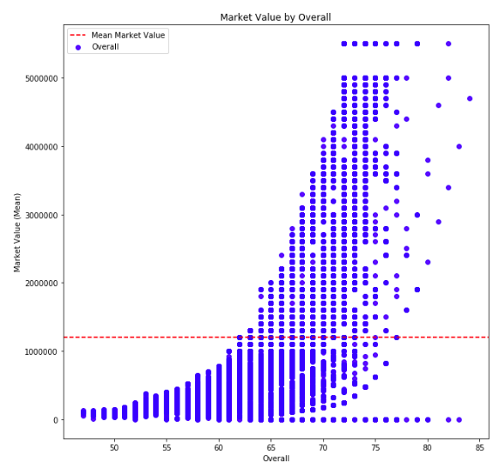
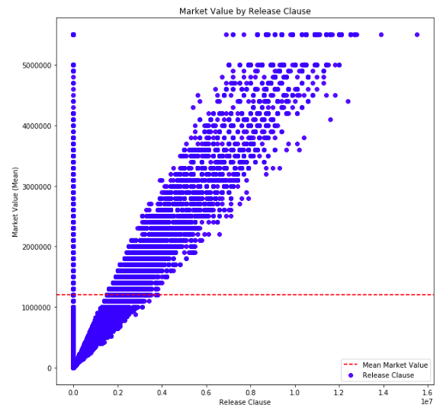
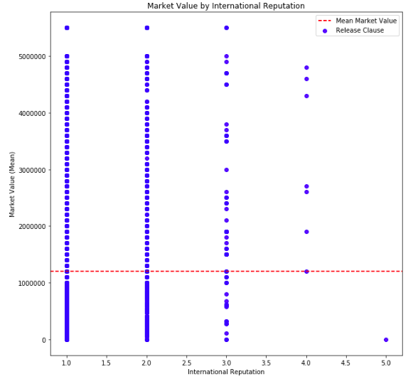
ONE OF THE CANDIDATES MODEL TO BE DISCARD:
We made several tests to see the best features to keep for our predictive model. We checked the R² and tried to find a result of > 0.7 to have a good model.
Features we decided to kept :
Overall
Release clause
International reputation
R² near to 1.0
Very suspicious
Let’s try to see which feature weights the most to use it for our predictive model.

Slide 13
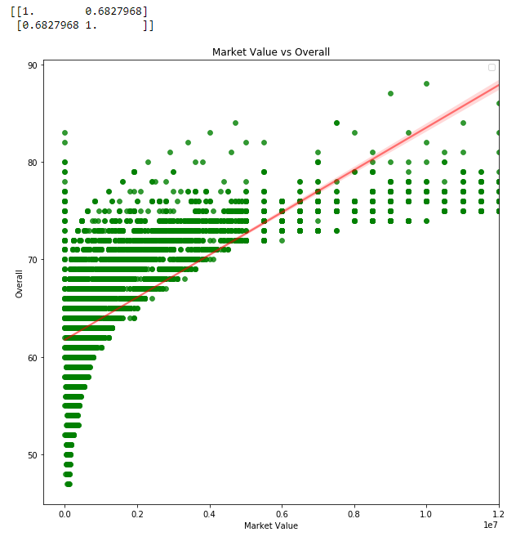
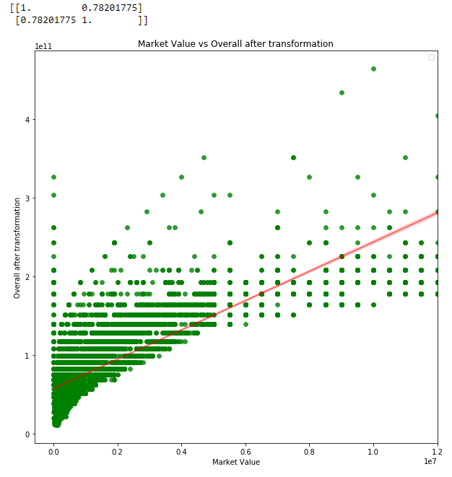
SOLUTION
We have analyzed if with any transformation of the more intuitive variable detected in the other candidate model, we obtain a better result with higher correlationship. We have done Overall^6 transformation.

Slide 14
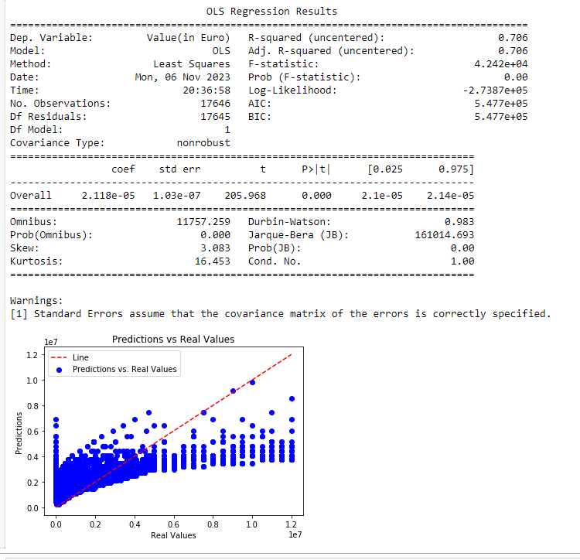
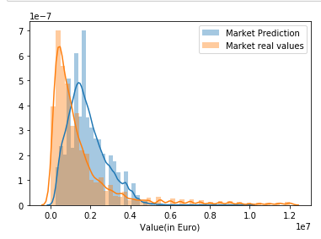
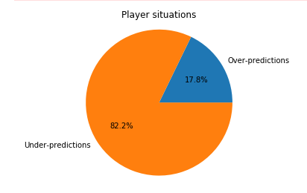
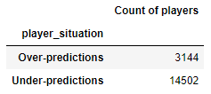
FINAL PROPOSAL
We have found a relationship between Overall and Market Value: Market Value = intercept + coef*(Overall)^6

Slide 15
BUCKETIZATION PROCESS

Slide 16
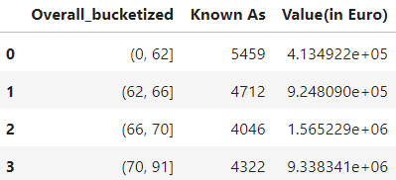
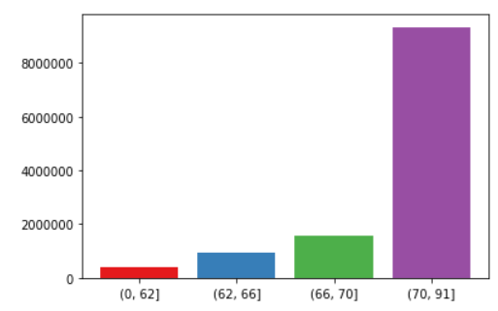
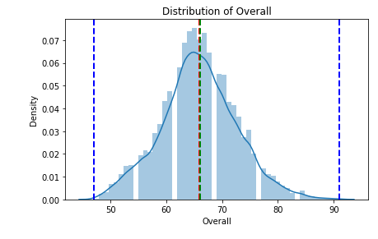
BUCKETIZATION PROCESS
Creation of buckets using as driver the Overall to obtain a mean of the market value in each bucket.

Slide 17
THANK YOU!

